Slide 1

Coastal Shallow-Water Data Buoy
BE-Mechatronics, SZABIST
FYP Final Year Evaluation (August 2017)
Team Members:
Rayan Isran (1345161)
Hafsa Mir (1345109)
Abdul Khalique (1245143)
Project Supervisor :
Dr. Raza Akbar

Slide 2
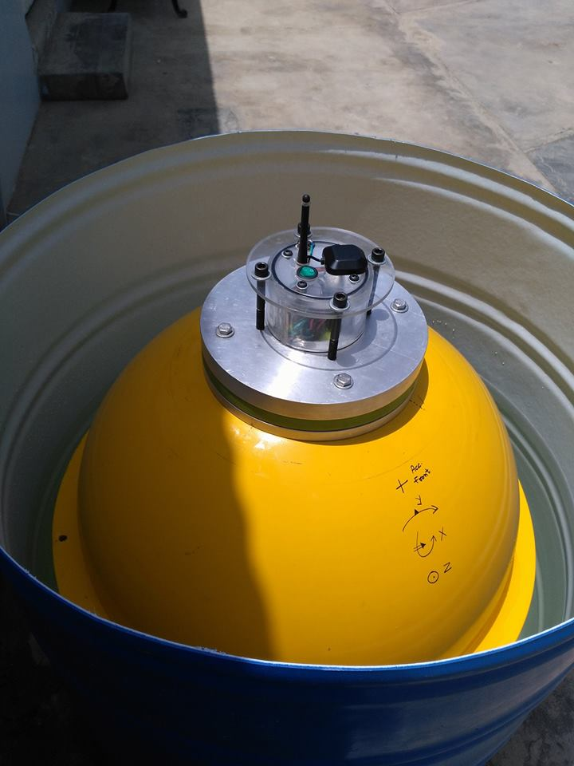
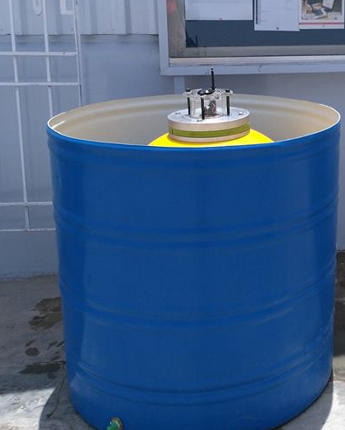
Introduction/Objective
A Data Buoy Is used to log wave heights at the coast.
The wave data can be used to assess wave action on the coasts and their effects on fauna and flora.
Long term wave data studies can be made to develop local wave trends.

Slide 3
Design Flow Diagram
Discs Design
Canister Design
External Shell Design
Draft Design
Machine Drawings
Material Selection
Stress Analysis
Weight Analysis
Improved Design
Fabrication

Slide 4
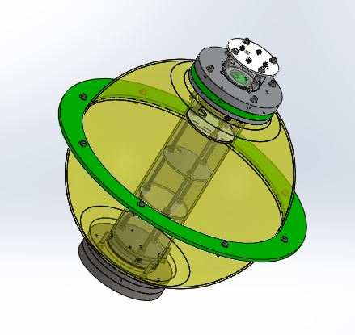
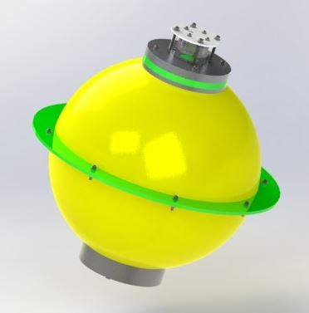
Design
The structure is mainly divided into an inner structure and outer structure.
Both sections have been designed taking into account various points of concern such as leakage, corrosion, weight, acting stresses and factor of safety.

Slide 5
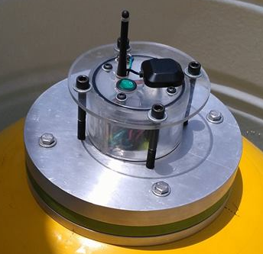
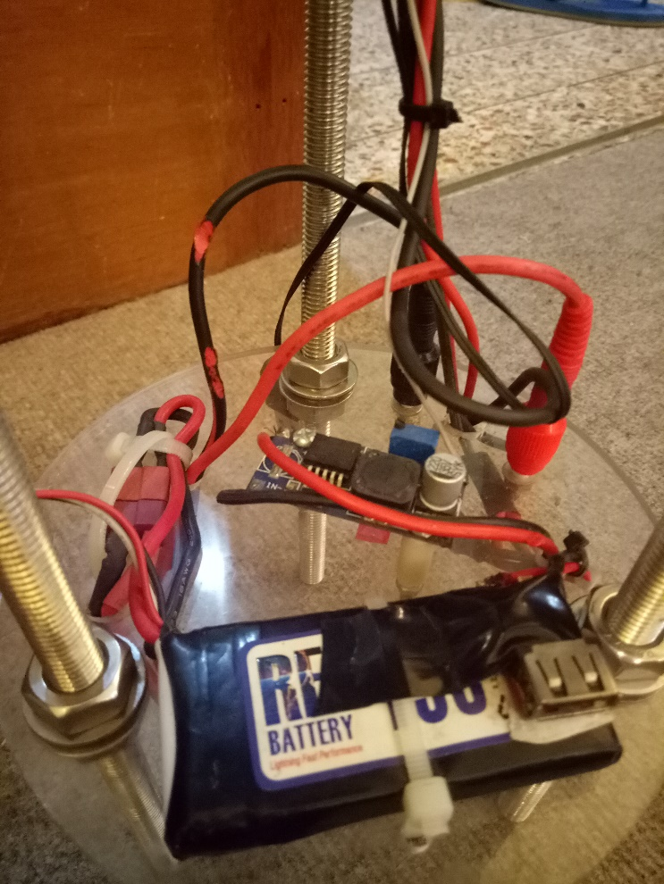
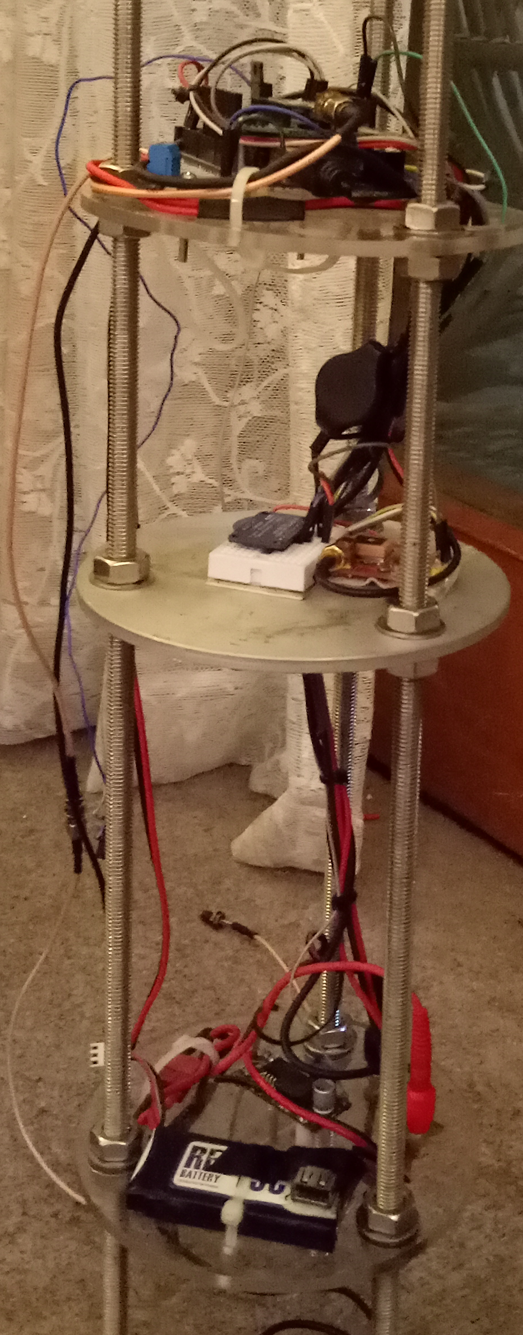
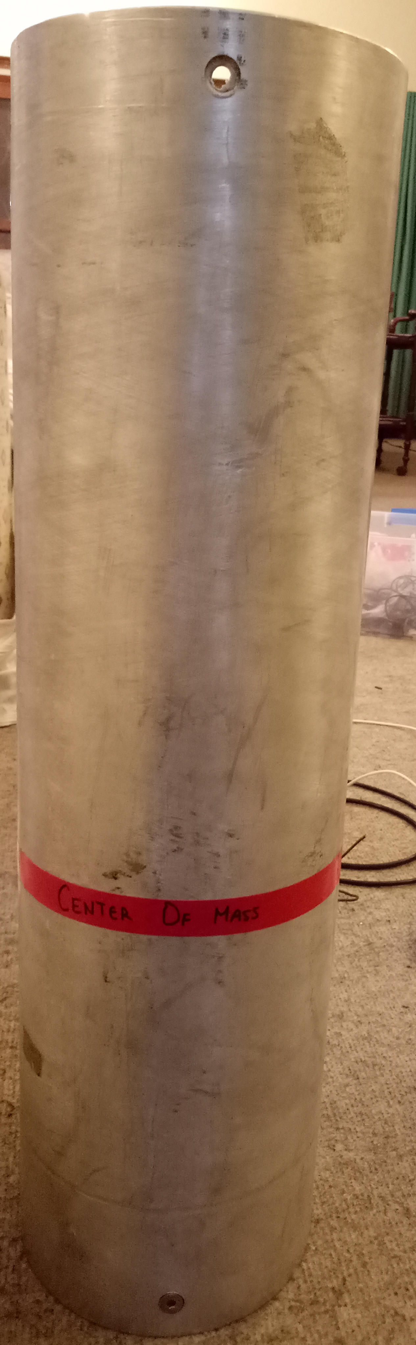

Slide 6
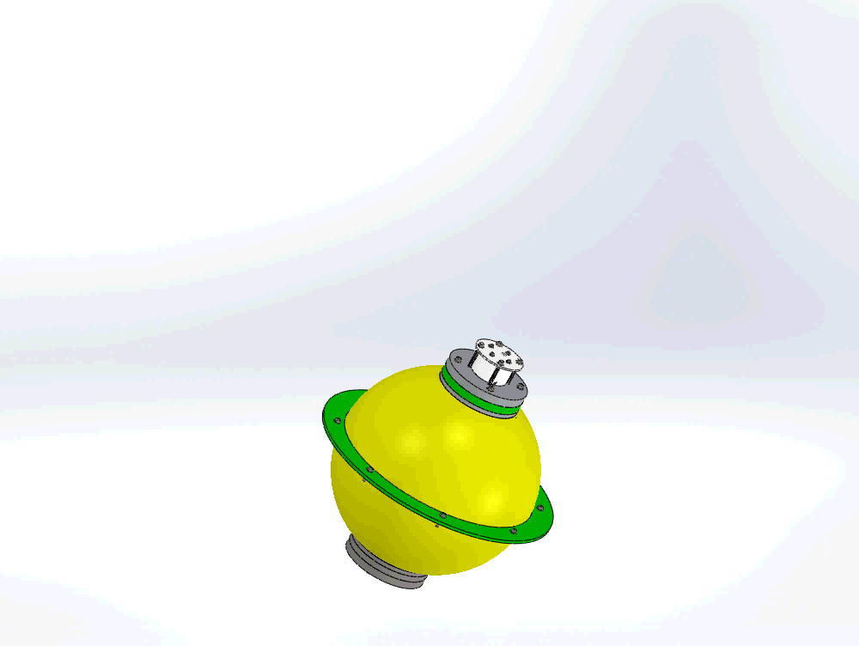

Slide 7
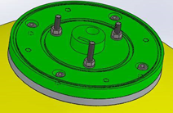
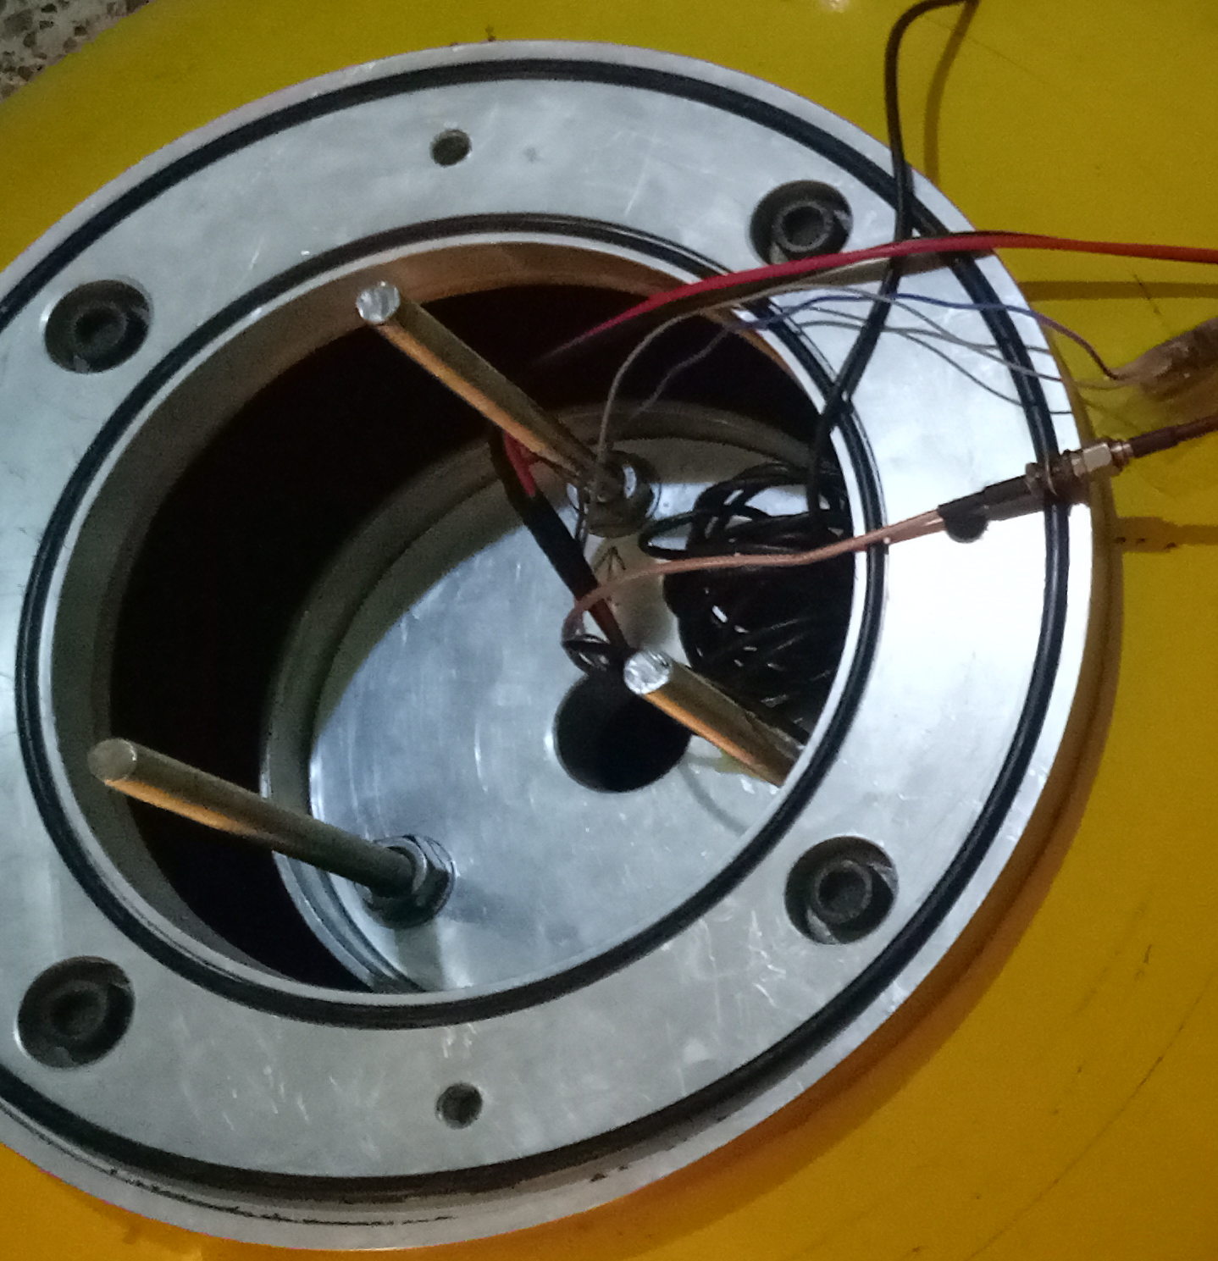
Sealing
Sealing was done to make the buoy water tight. O-rings were used to provide sealing.
O-rings are placed at each level where ever there is a leak path.
O-ring grooves
O-rings
Notes:
The canister is sealed using dynamic O-rings at its top and bottom. This provides additional protection to the components inside the canister.

Slide 8
Corrosion
The buoy must be corrosion resistant as it sits directly in salt water.
The shell is made of fiberglass because it is less vulnerable to corrosion than steel and aluminum.
The plates at the bottom are made of stainless steel 316L.
Molykote anti-seize compound was used to coat the fasteners in order to facilitate disassembly and resist corrosion.

Slide 9
Stress Analysis
To determine the maximum stress and its location on each part.
To determine the required thickness of each part.
As the fiber glass exhibits somehow between ductile and brittle behavior, hence, the factor of safety is calculated using the following criterion:
Criterion | Max. Stress (MPa) | F.O.S
Distortion Energy Theory | 61.7 | 3.35
Max. Normal Stress Theory | 77.2 | 2.7
Max. Shear Stress Theory | 34.8 | 2.97

Slide 10
Sensitivity Analysis
A sensitivity analysis was performed in SolidWorks to study the variation in Center of Mass when the distance between the bottom and middle disc changes.
The Center of mass obtained proves to be almost insensitive to movement of the middle disc.
Distance Between Bottom and Middle Disc (mm) | Center of Mass (X) (mm) | Center of Mass (Y)
77 | 330.64 | - 0.07
100 | 330.08 | - 0.07
150 | 328.87 | - 0.07
175 | 328.26 | - 0.07
200 | 327.65 | - 0.07

Slide 11
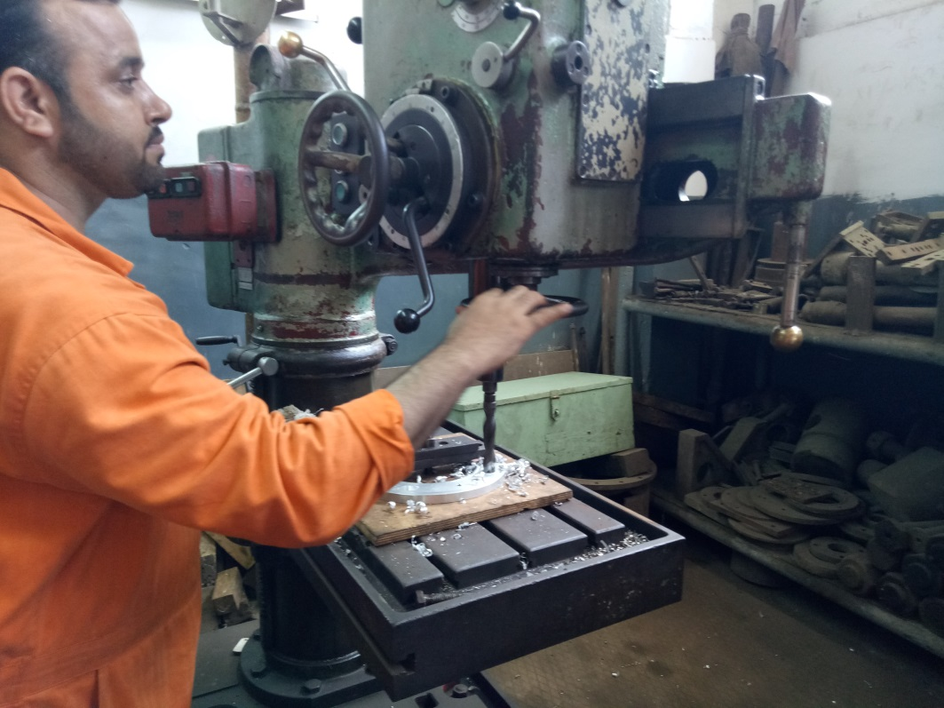
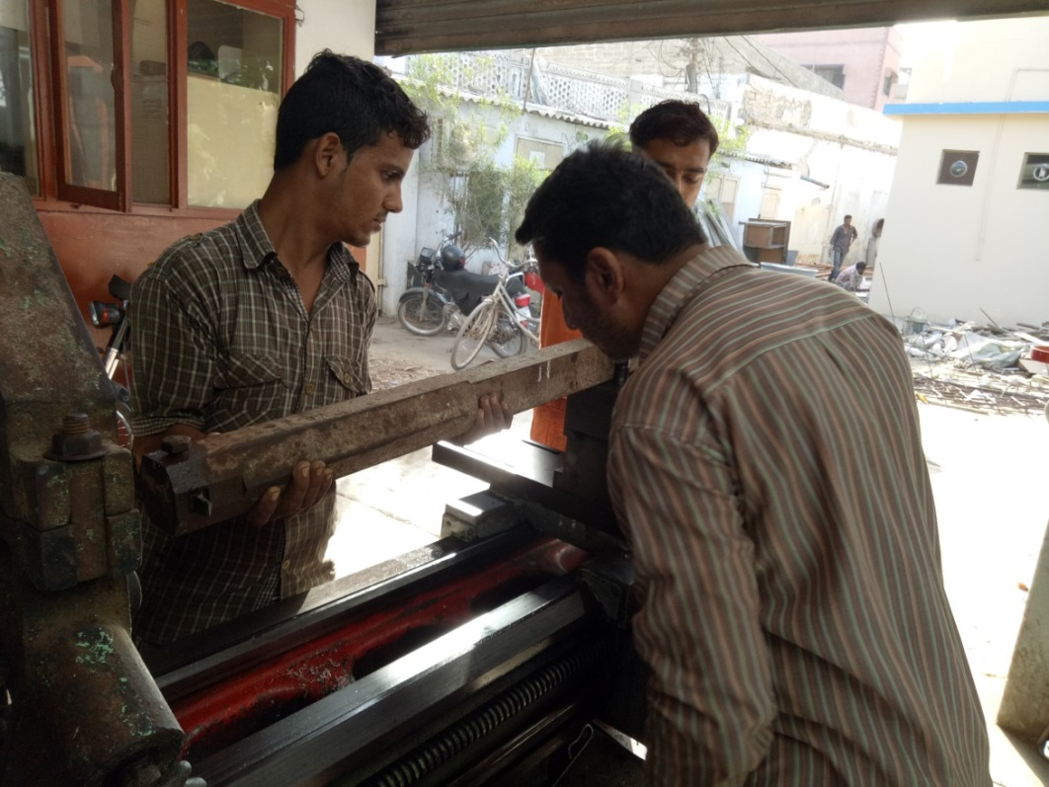
Machining
Machining was carried out by technicians at PNSC Kiamari Workshop (Picture Shown Below).
All the metal and plastic components were machined free of cost by PNSC after we approached them and introduced our project.

Slide 12
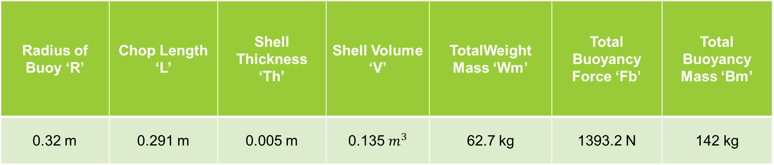
Weight and Buoyancy Analysis
Weight and Buoyancy analysis was performed to find the radius of buoy for it to float considering the weight of the components that it will carry.
At present, the buoy sits below the centerline (hoop) and has capacity to carry extra 10 kg.
Radius of Buoy ‘R’ | Chop Length ‘L’ | Shell Thickness ‘Th’ | Shell Volume ‘V’ | TotalWeight Mass ‘Wm’ | Total Buoyancy Force ‘Fb’ | Total Buoyancy Mass ‘Bm’
0.32 m | 0.291 m | 0.005 m | 0.135 $m^{3}$ | 62.7 kg | 1393.2 N | 142 kg
Notes:
Condition for the buoy to float and sit ‘half in and half out’ of the water is that the buoyancy mass needs to be double the weight mass so that the buoy’s weight mass displaces half of the buoyancy mass and the other half of the buoyancy mass keeps the buoy afloat.

Slide 13
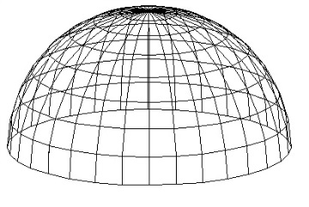
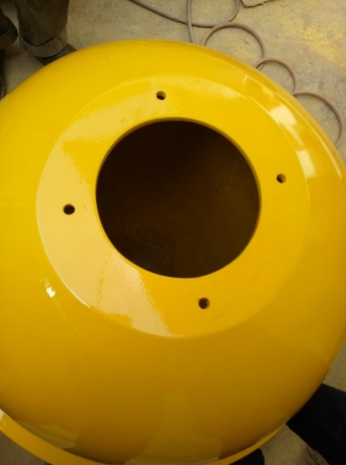
Fiberglass Shell Manufacturing
Fiberglass was manufactured at a local, Malir based company.
Manufacturing process is as follows:
A hemispherical wire pattern of the buoy shape is made which is further used to make a fiberglass mold.
Layers of fiberglass (joined together by epoxy resin) are applied inside the mold to cast the final product.

Slide 14
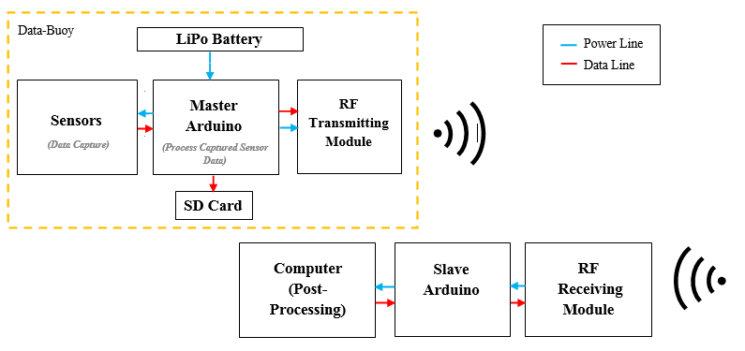
Data Acquisition

Slide 15
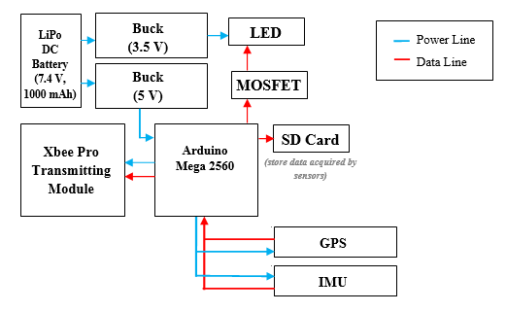

Slide 16
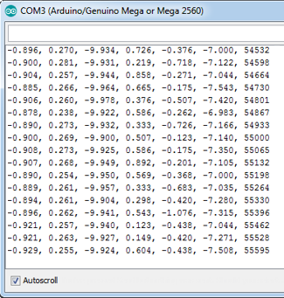
Testing
Accelerometer data coming every ~66ms (15 Hz) in the format Ax, Ay, Az, Gx, Gy, Gz
By double integrating the acceleration we can obtain the wave displacement
As we are only interested in the wave parallel to the coast we have neglected Ax/Ay and only considered Az, the vertical linear acceleration.

Slide 17


Results
We apply the trapezoidal rule to perform a numerical integration using the formula:
∫ A. dt

Slide 18

Results
Integrating the velocity readings we obtain the displacement of the coastal wave.
∫ V. dt

Slide 19
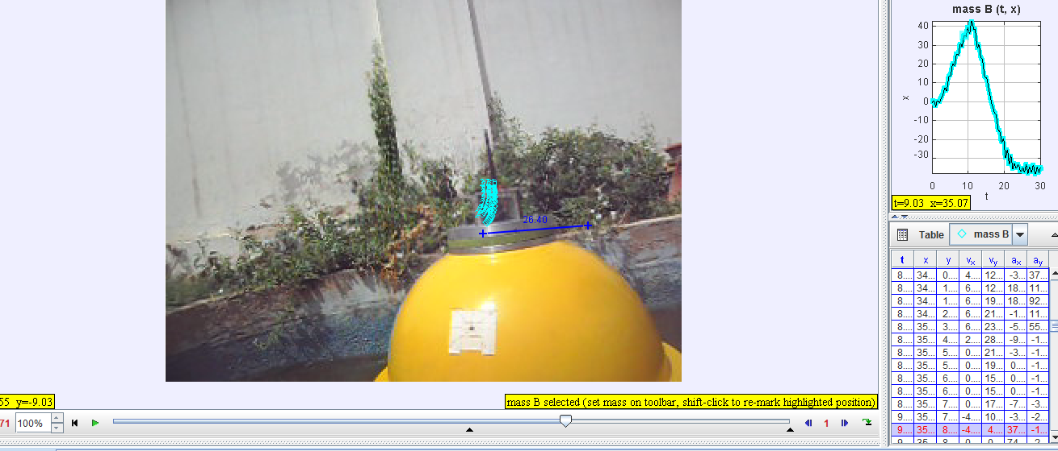
Results
To cross-check the data, we recorded a video of the buoy motion and analyzed the video in Tracker software:

Slide 20
Results
The displacement data can be obtained directly from Tracker after marking the same reference point in each frame of the video.
The results are compared to the accelerometer data and look very similar.
ACCELEROMETER DATA
VIDEO ANALYSIS

Slide 21
Results & Future Uses
In the event the buoy is deployed in a drifting mode, a GPS module onboard can transmit its location.
The location is broadcast via Xbee every 90 seconds and is accurate to 10 ~meters. The Xbee has a range of 500 meters approximately in a no-obstacle zone.
The buoy is also dual-purpose which means the container can be taken out and replaced with a WEC mechanism.

Slide 22

Thank You!

